Slide 1
Universal 2-Stage Integrated Furnace Controls
21M51U-843 for PSC Blowers
21V51U-843 for ECM Blowers

Slide 2
Business and Product Overview
21M51U-843 & 21V51U-843

Slide 3
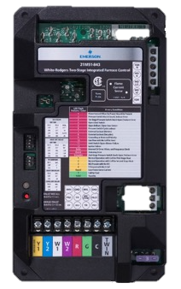
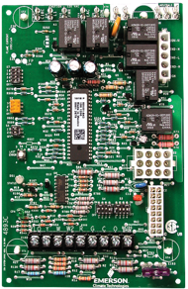

White-Rodgers Universal 2-Stage IFC
White-Rodgers 21M51U-843 & 21V51U-843 Universal 2-Stage Integrated Furnace Controls replace over 140 2-stage controls, offering a single microprocessor that oversees furnace functions including burner and blower operations.
Both controls include a 21D64-2 HotRod 120v Universal Ignitor, allowing for existing 80v ignition controls to be upgraded to 120v.
21M51U-843
21V51U-843
Universal 2-Stage IFCs

Slide 4
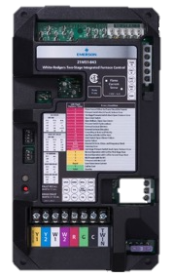

White-Rodgers Universal 2-Stage IFC
21M51U-843
21V51U-843
2-stage
HSI ignition furnaces
PSC Blower motors
2-stage
HSI ignition furnaces
ECM – Variable Speed Blower motors
90 Cross-references
54 Cross-references
Universal 2-Stage IFCs

Slide 5
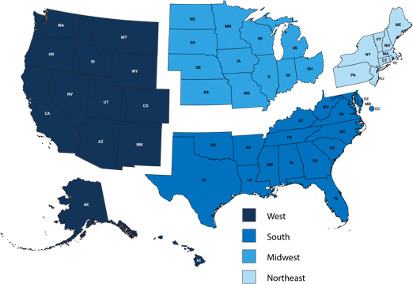
Market and Value Proposition
The US market for 2-stage applications offers a huge opportunity for replacements.
15.7 million* 2-stage gas furnaces were installed in the last twenty years in the US, so the replacement market for these controls should be strong, wherever you are.
2-Stage Home Market Projection: 15,735,000
2,780,000
7,480,000
3,390,000
2,085,000
*WR Estimate
Universal 2-Stage IFCs

Slide 6
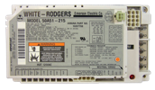
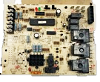

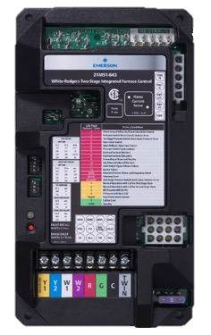
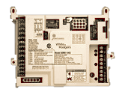

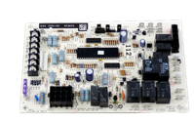


21M51U-843 Cross-Referenced Brands by Manufacturer
The 21M51U-843 replaces
90 different sku’s
Goodman / Amana
22 sku’s
Armstrong
6 sku’s
Johnstone
6 sku’s
Lennox
8 sku’s
White-Rodgers
3 sku’s
Trane / American Standard
25 sku’s
York / JCI
20 sku’s
TECH TIP: Included in every box is a full Cross Reference sheet.
Universal 2-Stage IFCs

Slide 7
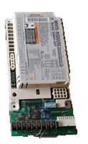
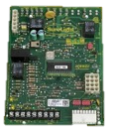

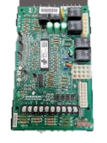



21V51U-843 Cross-Referenced Brands by Manufacturer
The 21V51U-843 replaces 54 different sku’s
Lennox
9 sku’s
Trane / American Standard
13 sku’s
White-Rodgers
1 sku
York / JCI
10 sku’s
Thermo Pride
1 sku
Goodman / Amana
20 sku’s
TECH TIP: Included in every box is a full Cross Reference sheet.
Universal 2-Stage IFCs

Slide 8
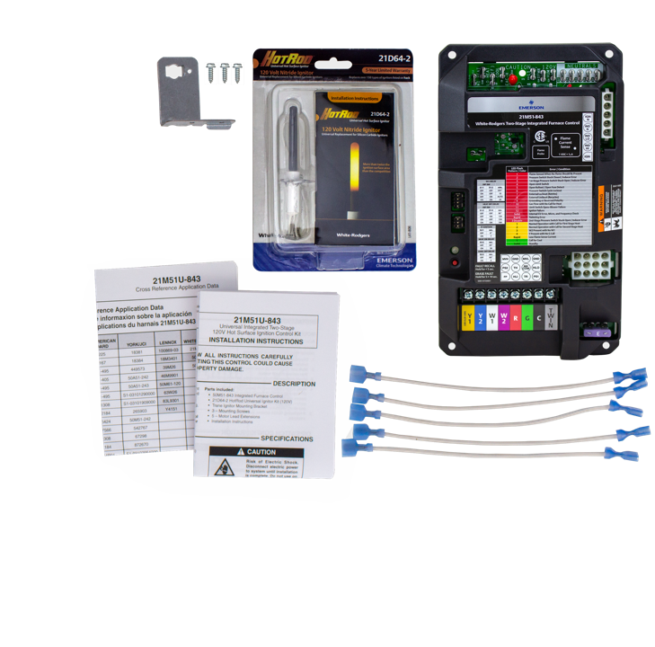
21M51U-843 What’s in the Box?
21M51U-843 2-Stage PSC Universal Furnace Control
21D64-2 HotRod Ignitor
Trane Ignitor Mounting bracket with 3x ½” Screws
5 Motor Lead Extensions
Installation Sheet
Cross Reference Application Data Sheet (Shading indicates 80V application where ignitor must be changed to 120V)
Universal 2-Stage IFCs

Slide 9
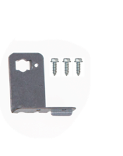
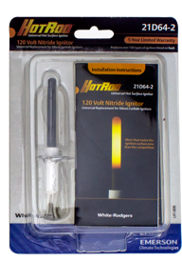
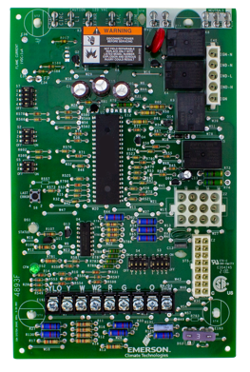
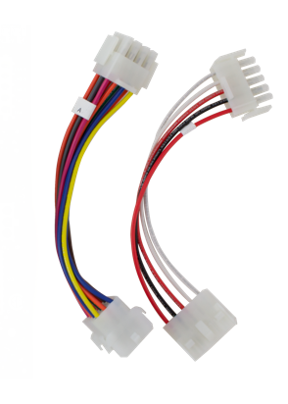
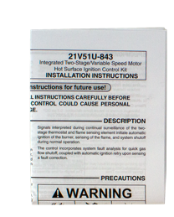
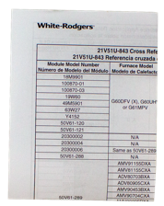
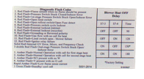
21V51U-843 What’s in the Box?
21V51U-843 ECM Universal Furnace Control
21D64-2 HotRod Ignitor
Trane Ignitor Mounting bracket with 3x ½” Screws
2 Adapter Interconnect Harnesses
Installation Sheet
Cross Reference Application Data Sheet (Shading indicates 80V application where ignitor must be changed to 120V)
Fault Code Adhesive Label
Universal 2-Stage IFCs

Slide 10
2-Stage Universal Features
FEATURE | White-Rodgers 21M51U-843 | White-Rodgers 21V51U-843
Board Cross References | 90 | 54
Ignitor Voltage Covered | 80v & 120v | 80v &120v
120v Universal (HotRod) Hot Surface Ignitor Included | ✔ | ✔
Current Flame Test Pads | ✔ | ✔
Twinning Capable | ✔ | ✘
Unused Motor / Park Terminals | 1 | N/A
Electronic Air Cleaner Voltage connections | 120v | 120v
Humidifier Voltage Connections | 120v | 120v
Status & Fault Tri-color LED indicator | Green – Amber – Red | Green – Amber – Red
Tri-color LED Displays Heat/Cool/Fan Status | ✔ | ✔
Status & Fault Code Label on Control | ✔ | ✔
Fault Recall & Clearing | Simple Push Button | Simple Push Button
Product Warranty | 1 Year | 1 Year
Universal 2-Stage IFCs

Slide 11





WR Mobile App
Always up-to-date and easy to use:
Mobile App
White-Rodgers Website
Your resource for:
Product information and spec sheets
Complete Cross Reference
OEM compatibility
Installation information and videos
Wiring diagrams
Download:
Go to your app store
Type in WR Mobile
Install the app
OR
Open your camera
Hold it over the QR code
Tap “Open” on the
pop-down
Install the app

Slide 12
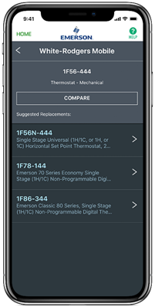
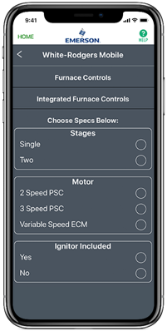
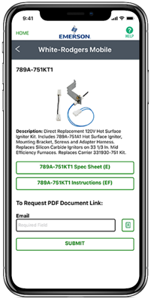
WR Mobile App
Easy to use!
Search by OEM, Competitive, or White-Rodgers Model Number
Product Number
Scrollable Product List
WR Replacement

Slide 13

White-Rodgers Cross Reference
Go to: www.whiterodgers.com
Hover over Tools & Resources
Click on: White-Rodgers Cross Reference/Product Information
Enter the Model Number or click on: Search Replacement Heating Controls by Major OEM Brand

Slide 14

Why Contractors Trust White-Rodgers
Industry Leading Products
Used by more OEM’s
Offering the widest range of Universal Replacement Controls
Ease of Installation
Simple, easy to understand instructions
Product Reliability
Quality Control assures reliable products
Affordable
Competitive pricing
Supported by Knowledgeable Representatives
Contractor direct phone support

Slide 15
Technical
21M51U-843 & 21V51U-843

Slide 16
White-Rodgers Universal 2-Stage IFC
White-Rodgers 21M51U-843 & 21V51U-843 Universal 2-Stage Integrated Furnace Controls replace over 140 2-stage controls, offering a single microprocessor that oversees furnace functions including burner and blower operations.
Both controls include a 21D64-2 HotRod 120v Universal Ignitor, allowing for existing 80v ignition controls to be upgraded to 120v.
21M51U-843
21V51U-843
Universal 2-Stage IFCs

Slide 17
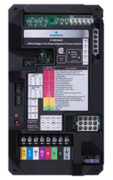
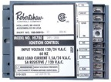
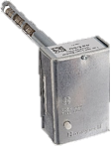
What is an IFC?
The term IFC is an acronym that stands for “Integrated Furnace Control”. Originally, furnaces had separate controls that operated the ignition and fuel burning separate from the blower motor. Now, the IFC monitors all functions and provides maximum safety with a single microprocessor.
IFC’s can:
  Monitor flue blockage for safety
  Operate an inducer motor
  Provide gas ignition and monitor to ensure burning
  Monitor furnace from overheating for safety
  Turn the fan blower on and off at the correct time
  Oversee all thermostat requests
  Provide status codes to verify current state
  Provide fault codes to help troubleshoot
✓
Universal 2-Stage IFCs

Slide 18

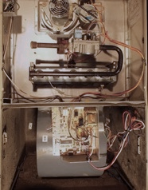
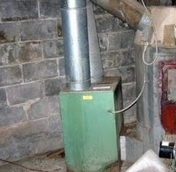
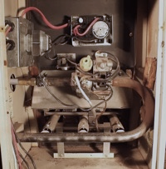
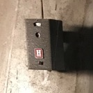
IFC History
1935
1968
1990
1988
An electric fan to distribute the heated air through ductwork of a coal fired furnace within the home is patented.
Mechanical temperature switches are used to control when the blower turns on/off.
An Intermittent Spark ignition system is introduced to replace Standing Pilot Systems.
A Furnace Blower Control that uses a microprocessor to time the fan blower on & off instead of a temperature sensing control is patented.
A fully Integrated Furnace Control that controls the gas valve, gas ignition, flame sensing, blower fan operation, induced draft sensing, & limit functions is patented.
IFC’s can turn on blowers and turn off gas in an overheating event.
Era when non-integrated controls operated furnaces
Universal 2-Stage IFCs
Notes:
Annual board sales still estimated at 80k-100k
Main users w/ the SmartValve were ICP, Lennox (Armstrong, Ducane), and York (Coleman/Evecon)

Slide 19
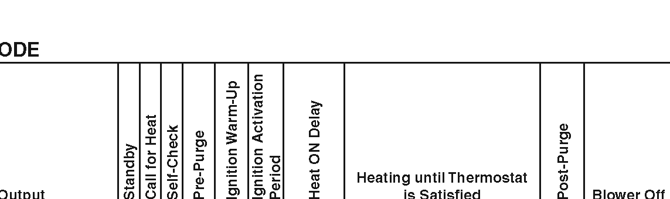
2-Stage Gas Operation
2-Stage furnaces operate with 2 levels of heating:
  A Low fire @ 60%-70% full capacity
  A High fire @ 100% full capacity
Stages can be controlled by several methods:
  A single stage thermostat and IFC dipswitch settings
    W2 (2nd stage) can be set to come on
      For a predetermined amount of time
      Automatically based on operation algorithms
  A 2-Stage thermostat
    W2 (2nd stage) is connected to W2 on the thermostat
TECH TIP: Properly sized & set-up 2-Stage furnaces operate quieter 60-80% of the time by burning on low fire.
Universal 2-Stage IFCs

Slide 20
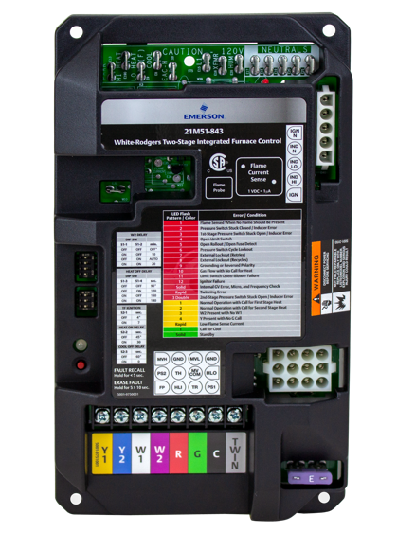
2-Stage Universal IFC
21M51U-843 for PSC Blowers
Technical Overview

Slide 21

White-Rodgers 21M51U-843 Components
120v Components:
Other Components:
Blower Speed Park Spade
PSC Blower Hi-Heat Spade
PSC Blower Lo-Heat Spade
PSC Blower Cool Spade
120v EAC Spade
Line 120v Input Spade
120v Transformer Spade
120v Humidifier Spade
5 Line Neutral Spades
5-pin Inducer/Ignitor Molex Plug
18
18
Flame Sense Test Pads
Flame Sense 3/16” Spade
Heat Delay Dipswitches
Ignition & Blower Dipswitches
Status / Fault LED
Fault Recall Button
Fault Code Label
Mounting Holes
2
4
6
8
9
1
3
5
7
10
12
11
13
17
14
15
16
20
24v Components:
24v Thermostat Bus
12-pin Molex Connector
3a Low Voltage Fuse
19
21
18
18
Universal 2-Stage IFCs

Slide 22
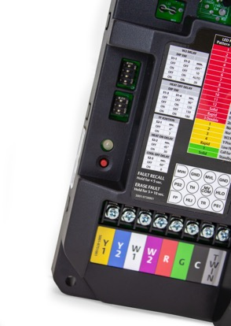
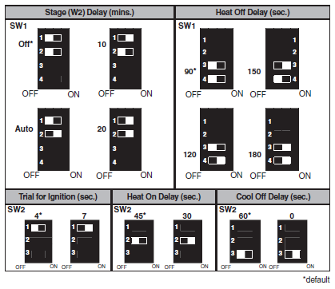
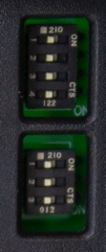
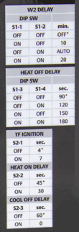
Adjustable Dipswitch Functions
Note: Power must be cycled after dipswitch settings are made.
TECH TIP: White-Rodgers identifies the dipswitch settings with a label on the control and in the instruction sheet.
Universal 2-Stage IFCs

Slide 23
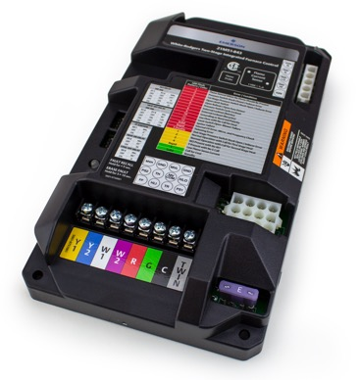
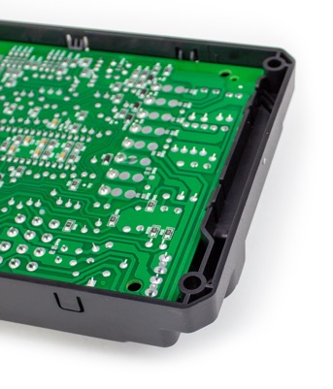
Easy-to-Install Mounting
The 21M51U-843 has 4 corner mounting holes designed to give multiple installation options.
White-Rodgers raised molded base provides space between board and unit mounting plate.
Up to 4x 1" screws can be used.
Universal 2-Stage IFCs

Slide 24
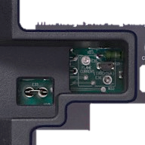
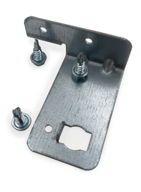
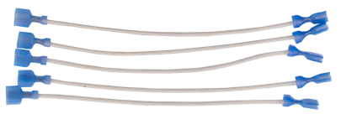
Key OEM Features Matched by White-Rodgers
Lennox
Trane
Amana / York
All Brands
Lennox applications use a separate flame sense wire which connects to the 3/16” flame sense spade.
All other systems utilize flame sense through the 12-pin molex plug.
The replacement of the hot surface ignitor on Trane systems requires a special mounting bracket which is included in the 21M51U-843 box.
When replacing Amana 50A51-225 or 50A51-235 and York 50A51-243 controls a line voltage wire labeled “Circ Input” should be taped & tied off. It is a duplicate line voltage wire that is not needed.
In some applications the blower motor wires may not be long enough to reach the new control. 5x ¼” spade wire extensions are included in the 21M51U-843 box.
Universal 2-Stage IFCs
9
9

Slide 25

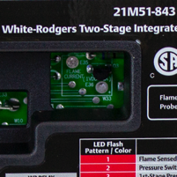
Utilizing the Flame Current Test Pads
Understanding Test Pads
White-Rodgers allows you to read flame current with a simple DCv meter by testing directly on the board without breaking the circuit to the probe.
To Test:
The furnace must have a call for heat and the burners producing flame
Set a multimeter to vDC and place a meter probe on each pad
Convert vDc to MicroAmps using a 1:1 ratio
A good flame sense reading will be between 1.0 – 5.0 μA
Test Pads
Universal 2-Stage IFCs

Slide 26
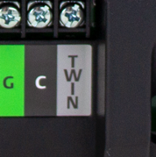
Twinning Feature
Two 21M51U-843 controls can be connected to operate simultaneously.
Twinning requires a connection of the Twin terminal on both boards using an 18ga wire.
The board with the thermostat connection will fully function, including the LED indicator and dipswitch settings. The twinned board will operate simultaneously as determined by the wired board unless “W” or “Y” are powered to it.
The twinned unit can be set for 2-stage Heat to come on by utilizing the “W” & W2” terminals or a single stage thermostat with the dipswitches staged.
Universal 2-Stage IFCs

Slide 27
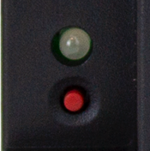
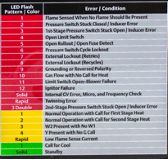
Status & Fault Codes for Troubleshooting
Easy to see tri-color LED indicator shows fault/error conditions
The Fault Button allows for:
  Recall of the last 5 faults
  Fault Code deletion
Troubleshooting is simplified with a Fault Code / Status Label on the control cover
Tri-Color LED
Universal 2-Stage IFCs
Notes:
The software code has been modified with new pressure switch criteria. When the pressure switch trips 3 times, there is a 3-hour lock-out.

Slide 28
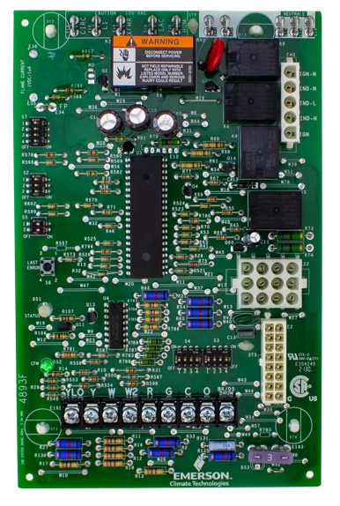
2-Stage Universal IFC
21V51U-843 for PSC Blowers
Technical Overview

Slide 29
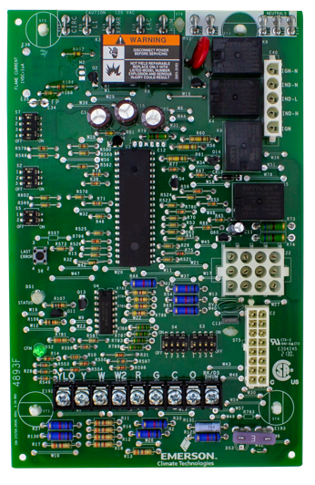
White-Rodgers 21V51U-843 Components
2
3
Other Components:
120v Components:
1
2
3
4
5
6
120v Circ Blower Input Spade
Line 120v Input Spade
120v Transformer Spade
120v EAC Spade
120v Humidifier Spade
5 Line Neutral Spades
5-pin Inducer/Ignitor Molex Plug
21
ECM Dipswitches
Blower CFM LED
Status / Fault LED
Last Error / Fault Button
Heat-Pump & Dehumidification Dipswitches
Furnace Manufacturer Dipswitches
Thermostat & Heat Fan Off Delay Dipswitches
Flame Sense 3/16” Spade
Flame Sense Test Pads
4 Mounting posts
21
20
7
18
19
17
16
15
8
14
12
24v Components:
13
9
12-pin Molex Connector
16-pin ECM Connector
3a Low Voltage Fuse
24v Thermostat Bus
11
21
21
10
Universal 2-Stage IFCs

Slide 30
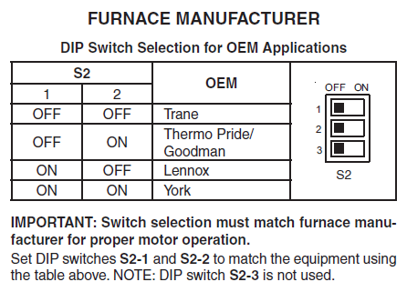
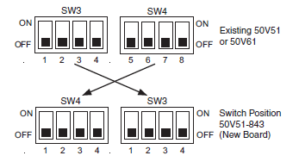

ECM Set-up & Operation
The settings for the ECM Blower Motor 16-pin are determined by dipswitches S2, S3 and S4. S2 sets the manufacturer and S3 & S4 sets motor configuration.
S2 Settings
S3 & S4 Settings
In some applications the dipswitch locations are reversed
Verify dipswitches are set to match the replaced control board
Universal 2-Stage IFCs
Notes:
The software code has been modified with new pressure switch criteria. When the pressure switch trips 3 times, there is a 3-hour lock-out.

Slide 31
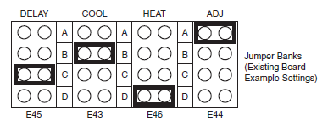


ECM Set-up & Operation Cont.
S3 & S4 Settings Cont.
For York applications, match the 4 shunt / jumpers configuration
Green LED
The 21V51U-843 comes with a green LED to indicate the Blower Motor CFM airflow
The flash code will match the furnace manufacturer detail when the blower is in operation
Universal 2-Stage IFCs
Notes:
The software code has been modified with new pressure switch criteria. When the pressure switch trips 3 times, there is a 3-hour lock-out.

Slide 32


Additional Dipswitch Functions
S7 Settings
Thermostat Type & Heat Blower Off Delay:
S7-1 & S7-2 Configure if a single or 2-stage thermostat is used
S7-3 & S7-4 Configure the Blower off Delay at the end of a Heat cycle
S5 Settings
Heat-Pump & De-Humidification:
Adjust S5-1 to Configure if a Heat-Pump is connected to the system
Adjust S5-2 is there is a De-humidification terminal connected to the thermostat
Note: Power must be cycled after dipswitch settings are made.
Universal 2-Stage IFCs

Slide 33


Raised Tab Mounting
The 21V51U-843 has 4 raised board supports designed to hold the board off the mounting surface.
Installation instructions include a template for hole spacing.
Universal 2-Stage IFCs

Slide 34

Key OEM Features Matched by White-Rodgers
Goodman
Trane
Lennox
For Goodman 50V51-289 applications, 2 adapter harnesses are included in the box.
The replacement of the hot surface ignitor on Trane systems require a special mounting bracket which is included in the 21M51U-843 box.
Lennox applications use a separate flame sense wire which connects to the 3/16” flame sense spade.
All other systems utilize flame sense through the 12-pin molex plug.
Universal 2-Stage IFCs
9
9

Slide 35

Utilizing the Flame Current Test Pads
Understanding Test Pads
2 pins extend from the control board to the surface of the black cover.
To Test:
The furnace must have a call for heat and the burners producing flame.
Set a multimeter to vDC and place a meter probe on each pad.
Convert vDc to MicroAmps using a 1:1 ratio.
A good flame sense reading will be between 1.0 – 5.0 μA.
Test Pads
TECH TIP: White-Rodgers allows you to read flame current with a simple DCv meter without breaking the circuit to the probe!
Universal 2-Stage IFCs

Slide 36


Status & Fault Codes for Troubleshooting
The Last Error / Fault Button allows for:
  Recall of the last 5 faults
  Fault Code deletion
Easy to see Tri-Color LED indicator shows Status & Fault / Error conditions
Troubleshooting is simplified with an included adhesive Fault Code Label that can be placed on the equipment.
The Label also includes Dipswitch S7 blower Heat Off Settings
Universal 2-Stage IFCs
Notes:
The software code has been modified with new pressure switch criteria. When the pressure switch trips 3 times, there is a 3-hour lock-out.

Slide 37
Install
21M51U-843 & 21V51U-843

Slide 38
2-Stage Gas Operation
2-Stage furnaces operate with 2 levels of heating:
  A Low fire @ 60%-70% full capacity
  A High fire @ 100% full capacity
Stages can be controlled by several methods:
  A single stage thermostat and IFC dipswitch settings
    W2 (2nd stage) can be set to come on
      For a predetermined amount of time
      Automatically based on operation algorithms
  A 2-stage thermostat
    W2 (2nd stage) is connected to W2 on the thermostat
TECH TIP: Properly sized & set-up 2-stage furnaces operate quieter 60-80% of the time by burning on low fire.
Universal 2-Stage IFCs

Slide 39
21M51U-843 What’s in the Box?
21M51U-843 2-Stage PSC Universal Furnace Control
21D64-2 HotRod Ignitor
Trane Ignitor Mounting bracket with 3x ½” Screws
5 Motor Lead Extensions
Installation Sheet
Cross Reference Application Data Sheet (Shading indicates 80V application where ignitor must be changed to 120V)
Universal 2-Stage IFCs

Slide 40
21V51U-843 What’s in the Box?
21V51U-843 ECM Universal Furnace Control
21D64-2 HotRod Ignitor
Trane Ignitor Mounting bracket with 3x ½” Screws
2 Adapter Interconnect Harnesses
Installation Sheet
Cross Reference Application Data Sheet (Shading indicates 80V application where ignitor must be changed to 120V)
Fault Code Adhesive Label
Universal 2-Stage IFCs

Slide 41


Disconnect Power and Gas
1
Turn off the power and gas to the furnace and remove the access panels. For this installation we will be using 21V51U-843.
Universal 2-Stage IFCs

Slide 42



Check Cross Reference
2
Check the old part number against the 21V51U-843 box cross reference or WR Mobile.
Universal 2-Stage IFCs

Slide 43

Take a Picture of Wiring
3
Take pictures before removing any wiring. Label existing wiring, as necessary.
Universal 2-Stage IFCs

Slide 44

Disconnect Wiring
4
Disconnect the 120v wiring to the circulator fan, the power supply coming in and power to the transformer as well as each neutral wire.
Universal 2-Stage IFCs

Slide 45

Disconnect Wiring
5
Disconnect the inducer/ignitor 5-pin molex plug, 12-pin molex connector and the 16-pin ECM connector.
Universal 2-Stage IFCs

Slide 46


Disconnect Wiring
6
Disconnect the thermostat wires and remove the board.
Universal 2-Stage IFCs

Slide 47


Adjust dipswitches
7
Adjust the dipswitches to match the furnace manufacture settings.
Universal 2-Stage IFCs

Slide 48


Install new board
8
Install the board and reconnect thermostat wires.
Universal 2-Stage IFCs

Slide 49


Reconnect Wiring
9
Reconnect molex plugs and 120v wiring.
Universal 2-Stage IFCs

Slide 50

Apply Label
10
Apply fault code adhesive label to furnace panel.
The label includes Dipswitch S7 blower Heat Off Settings
Universal 2-Stage IFCs

Slide 51

Connect Power and Gas
11
Replace the access panel. Restore the electrical power and gas supply. Refer to the furnace installation instructions for start-up and check-out procedures.
Universal 2-Stage IFCs

Slide 52
Thank you!
R-5427

